Slide 2
Challenges to Food Safety
A foodborne illness is a disease transmitted to people through food.
An illness is considered an outbreak when:
  Two or more people have the same symptoms after eating the same food
  An investigation is conducted by state and local regulatory authorities
  The outbreak is confirmed by laboratory analysis
1-2

Slide 3
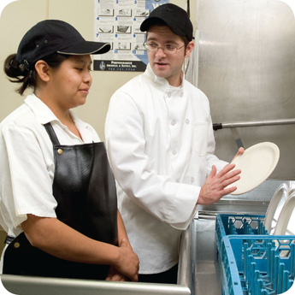
Challenges to Food Safety
Challenges include:
  Time and money
  Language and culture
  Literacy and education
  Pathogens
  Unapproved suppliers
  High-risk customers
  Staff turnover
1-3
Notes:
Instructor Notes
Pressure to work quickly can make it hard to take the time to follow food safety practices.
Your staff may speak a different language than you do, which can make it difficult to communicate. Cultural differences can also influence how food handlers view food safety.
Staff often have different levels of education, making it more challenging to teach them food safety.
Illness-causing microorganisms are more frequently found on food that once was considered safe.
Food that is received from suppliers that are not practicing food safety can cause a foodborne-illness outbreak.
The number of customers at high risk for getting a foodborne illness is increasing. An example of this is the growing elderly population.
Training new staff leaves less time for food safety training.
The ServSafe program will provide the tools needed to overcome the challenges in managing a good food safety program.

Slide 4
How Food Becomes Unsafe
Five risk factors for foodborne illness:
  Purchasing food from unsafe sources
  Failing to cook food correctly
  Holding food at incorrect temperatures
  Using contaminated equipment
  Practicing poor personal hygiene
1-4
Notes:
Instructor Notes
If food is not handled correctly, it can become unsafe. These are the five most common food-handling mistakes, or risk factors, that can cause foodborne illness.

Slide 5
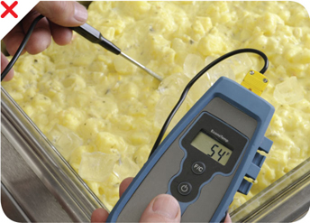
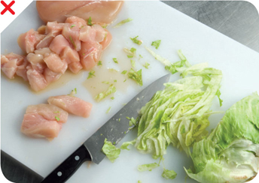
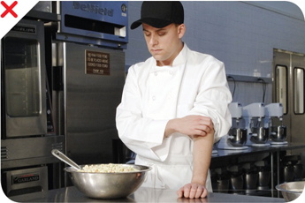
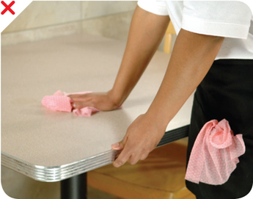
How Food Becomes Unsafe
Time-temperature abuse
Cross-contamination
Poor personal hygiene
Poor cleaning and sanitizing
1-5
Notes:
Instructor Notes
Except for purchasing food from unsafe sources, each risk factor for foodborne illness is related to four main factors: time-temperature abuse, cross-contamination, poor personal hygiene, and poor cleaning and sanitizing.

Slide 6
How Food Becomes Unsafe
Poor cleaning and sanitizing:
  Equipment and utensils are not washed, rinsed, and sanitized between uses
  Food contact surfaces are wiped clean instead of being washed, rinsed, and sanitized
  Wiping cloths are not stored in a sanitizer solution between uses
  Sanitizer solution was not prepared correctly
Pg 1.5 SSF 6e
1-6

Slide 7
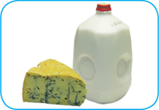
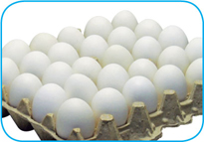
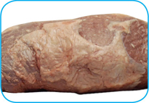
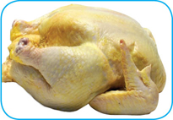
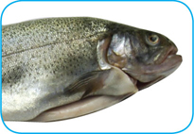
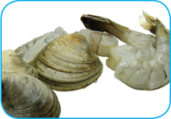
Food Most Likely to Become Unsafe
TCS food:
1-7
Notes:
Instructor Notes
The list of TCS food includes the following:
Milk and dairy products
Shell eggs (except those treated to eliminate Salmonella spp.)
Meat: beef, pork, and lamb
Poultry
Fish
Shellfish and crustaceans

Slide 8
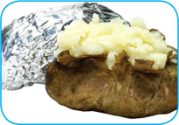
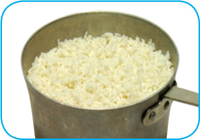

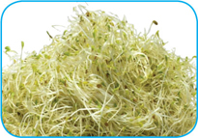
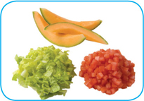
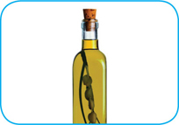
Food Most Likely to Become Unsafe
TCS food:
1-8
Notes:
Instructor Notes
The list of TCS food includes the following:
Baked potatoes
Heat-treated plant food, such as cooked rice, beans, and vegetables
Tofu or other soy protein; synthetic ingredients, such as textured soy protein in meat alternatives
Sprouts and sprout seeds
Sliced melons; cut tomatoes; cut leafy greens
Untreated garlic-and-oil mixtures

Slide 9
Ready-to-Eat Food
  Ready-to-eat food is food that can be eaten without further:
  Preparation
  Washing
  Cooking
Ready-to-eat food includes:
  Cooked food
  Washed fruit and vegetables
  Deli meat
  Bakery items
  Sugar, spices, and seasonings
1-9
Notes:
Instructor Notes
Like TCS food, ready-to-eat food also needs careful handling to prevent contamination.

Slide 10

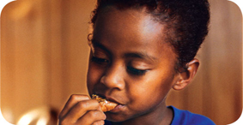
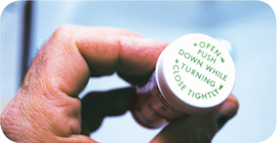
Populations at High Risk for Foodborne Illnesses
These people have a higher risk of getting a foodborne illness:
  Elderly people
  Preschool-age children
  People with compromised immune systems
1-10
Notes:
Instructor Notes
Elderly people are at high risk because their immune systems have weakened with age.
Very young children are at high risk because they have not built up strong immune systems.
People with compromised immune systems include:
People with cancer or on chemotherapy
People with HIV/AIDS
Transplant recipients
People taking certain medications

Slide 11
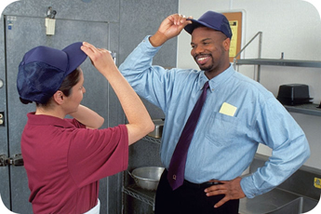
Keeping Food Safe
  Focus on these measures:
  Controlling time and temperature
  Preventing cross-contamination
  Practicing personal hygiene
  Purchasing from approved, reputable suppliers
  Cleaning and sanitizing
1-11
Notes:
Instructor Notes
Set up standard operating procedures that focus on these areas. The ServSafe program will show you how to design these procedures.

Slide 12
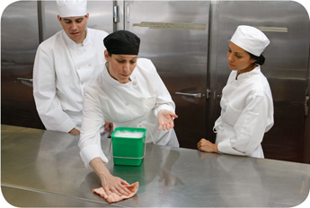
Keeping Food Safe
  Training and monitoring:
  Train staff to follow food safety procedures
  Provide initial and ongoing training
  Provide all staff with general food
  safety knowledge
  Provide job specific food safety training
  Retrain staff regularly
  Monitor staff to make sure they are following procedures
  Document training
1-12
Notes:
Instructor Notes
Managers must set up standard operating procedures that focus on the measures listed on the slide. Then they must train their staff on these procedures and monitor them to make sure the procedures are followed.

Slide 13
Keeping Food Safe
  Government agencies:
  The Food and Drug Administration (FDA)
  U.S. Department of Agriculture (USDA)
  Centers for Disease Control and Prevention (CDC)
  U.S. Public Health Service (PHS)
  State and local regulatory authorities
1-13
Notes:
Instructor Notes
The Food and Drug Administration (FDA) inspects all food except meat, poultry, and eggs. The agency also regulates food transported across state lines. In addition, the agency issues the FDA Food Code, which provides recommendations for food safety regulations.
The U.S. Department of Agriculture (USDA) regulates and inspects meat, poultry, and eggs. It also regulates food that crosses state boundaries or involves more than one state.
Agencies such as the Centers for Disease Control and Prevention (CDC) and the U. S. Public Health Service (PHS) conduct research into the causes of foodborne-illness outbreaks.
State and local regulatory authorities write or adopt code that regulates retail and foodservice operations.

Slide 15
How Contamination Happens
Contaminants come from a variety of places:
  Animals we use for food
  Air, contaminated water, and dirt
  People
    Deliberately
    Accidentally
2-2
Notes:
Instructor Notes
Contamination comes from a variety of places.
Contaminants can cause foodborne illness or result in physical injury.
Contaminants are found in the animals we use for food, the air, water, dirt; and they occur naturally in food, such as bones in fish.
Food can be contaminated on purpose.
Most food is contaminated accidently.
Examples of accidental contamination include: food handlers who don’t wash their hands after using the restroom, and then contaminate food and surfaces with feces from their fingers; and food handlers who pass contaminants through illness.

Slide 16
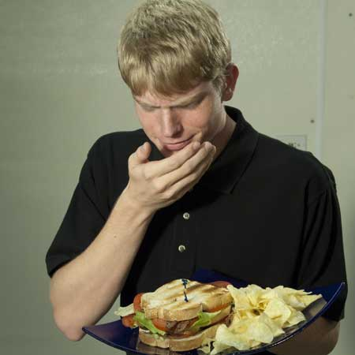
How Contamination Happens
People can contaminate food when:
  They do not wash their hands after using
  the restroom
  They are in contact with a person who is sick
  They sneeze or vomit onto food or food-contact surfaces
  They touch dirty food-contact surfaces and equipment and then touch food
2-3
Notes:
Instructor Notes
Food handlers who don’t wash their hands after using the restroom may contaminate food and surfaces with feces from their fingers. Once the food that the food handler touched is eaten, a foodborne illness may result. This is called the fecal-oral route of contamination.

Slide 17
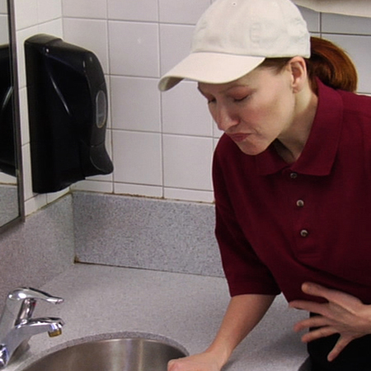
Biological Contamination
  Common symptoms of foodborne illness:
  Diarrhea
  Vomiting
  Fever
  Nausea
  Abdominal cramps
  Jaundice (yellowing of skin and eyes)
  Onset times:
  Depend on the type of foodborne illness
  Can range from 30 minutes to six weeks
2-4
Notes:
Instructor Notes
The symptoms of a foodborne illness vary depending on which illness a person has. But most victims of foodborne illness share some common symptoms.
Not every person who is sick from a foodborne illness will have all of these symptoms. Nor are the symptoms of a foodborne illness limited to this list.
How quickly foodborne-illness symptoms appear in a person is known as the onset time of the illness. Onset times depend on the type of foodborne illness a person has. They can range from 30 minutes to as long as six weeks. How severe the illness is can also vary, from mild diarrhea to death.

Slide 18
Major Bacteria That Cause Foodborne Illness
The FDA has identified three types of bacteria that cause severe illness and are highly contagious:
  Salmonella Typhi
  Shigella spp.
  Enterohemorrhagic and shiga toxin-producing Escherichia coli
2-5
Notes:
Instructor Notes
Food handlers with illnesses from these bacteria can NEVER work in a foodservice operation while they are sick.
These three bacteria are included in the FDA’s “Big Five” pathogens.

Slide 19
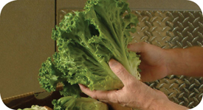
Major Bacteria That Cause Foodborne Illness
Bacteria: Salmonella Typhi (SAL-me-NEL-uh TI-fee)
Source: People
Food Linked with the Bacteria | Prevention Measures
Ready-to-eat food Beverages | Exclude food handlers diagnosed with an illness caused by Salmonella Typhi from the operation
 | Wash hands
 | Cook food to minimum internal temperatures
2-6
Notes:
Instructor Notes
Salmonella Typhi lives only in humans.
People with typhoid fever carry the bacteria in their bloodstream and intestinal tract.
Eating only a small amount of these bacteria can make a person sick.
The severity of symptoms depends on the health of the person and the amount of bacteria eaten. The bacteria are often in a person’s feces for weeks after symptoms have ended.

Slide 20
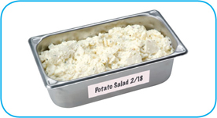
Major Bacteria That Cause Foodborne Illness
Bacteria: Shigella spp. (shi-GEL-uh)
Source: Human feces
Food Linked with the Bacteria | Prevention Measures
Food easily contaminated by hands, such as salads containing TCS food (potato, tuna, shrimp, macaroni, chicken) | Exclude food handlers diagnosed with an illness caused by Shigella spp. from the operation Exclude food handlers who have diarrhea from the operation
Food that has made contact with contaminated water, such as produce | Wash hands
 | Control flies inside and outside the operation
2-7
Notes:
Instructor Notes
Shigella spp. is found in the feces of humans with the illness.
Most illnesses occur when people eat or drink contaminated food or water.
Flies can also transfer the bacteria from feces to food.
Eating only a small amount of these bacteria can make a person sick.
High levels of the bacteria are often in a person’s feces for weeks after symptoms have ended.

Slide 21
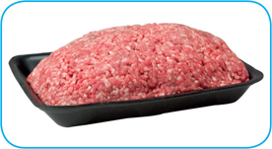
Major Bacteria That Cause Foodborne Illness
Bacteria: Enterohemorrhagic and shiga toxin-producing
Escherichia coli (ess-chur-EE-kee-UH-KO-LI)
Source: Intestines of cattle; infected people
Food Linked with the Bacteria | Prevention Measures
Ground beef (raw and undercooked) Contaminated produce | Exclude food handlers who have diarrhea or have been diagnosed with a disease from the bacteria Cook food, especially ground beef, to minimum internal temperatures
 | Purchase produce from approved, reputable suppliers
 | Prevent cross-contamination between raw meat and ready-to-eat food
2-8
Notes:
Instructor Notes
Enterohemorrhagic and shiga toxin-producing E. coli can be found in the intestines of cattle.
It is also found in infected people.
The bacteria can contaminate meat during slaughtering.
Eating only a small amount of the bacteria can make a person sick.
Once eaten, it produces toxins in the intestines, which cause the illness.
The bacteria are often in a person’s feces for weeks after symptoms have ended.

Slide 22
Major Viruses that Cause Foodborne Illnesses
The FDA has identified two viruses that are highly contagious
and can cause severe illness:
  Hepatitis A
  Norovirus
  Food handlers diagnosed with an illness from hepatitis A or Norovirus must not work in an operation while they are sick.
2-9
Notes:
Instructor Notes
These two viruses are included in the FDA’s “Big Five” pathogens.

Slide 23
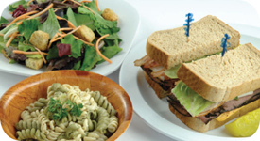
Major Viruses That Cause Foodborne Illness
Virus: Hepatitis A (HEP-a-TI-tiss)
Source: Human feces
Food Linked with the Virus | Prevention Measures
Ready-to-eat food Shellfish from contaminated water | Exclude staff who have been diagnosed with hepatitis A from the operation
 | Exclude staff who have jaundice from the operation
 | Wash hands
 | Avoid bare-hand contact with ready-to-eat food
 | Purchase shellfish from approved, reputable suppliers
2-10
Notes:
Instructor Notes
Hepatitis A is mainly found in the feces of people infected with it.
The virus can contaminate water and many types of food.
It is commonly linked with ready-to-eat food. However, it has also been linked with shellfish from contaminated water.
The virus is often transferred to food when infected food handlers touch food or equipment with fingers that have feces on them.
Eating only a small amount of the virus can make a person sick.
An infected person may not show symptoms for weeks but can be very infectious.
Cooking does not destroy hepatitis A.

Slide 24
Major Viruses That Cause Foodborne Illness
Virus: Norovirus (NOR-o-VI-rus)
Source: Human feces
Food Linked with the Virus | Prevention Measures
Ready-to-eat food Shellfish from contaminated water | Exclude staff who have been diagnosed with Norovirus from the operation
 | Exclude staff who have diarrhea and vomiting from the operation
 | Wash hands
 | Avoid bare-hand contact with ready-to-eat food
 | Purchase shellfish from approved, reputable suppliers
2-11
Notes:
Instructor Notes
Like hepatitis A, Norovirus is commonly linked with ready-to-eat food.
It has also been linked with contaminated water.
Norovirus is often transferred to food when infected food handlers touch food or equipment with fingers that have feces on them.
Eating only a small amount of Norovirus can make a person sick. It is also very contagious.
People become contagious within a few hours after eating it.
The virus is often in a person’s feces for days after symptoms have ended.

Slide 25
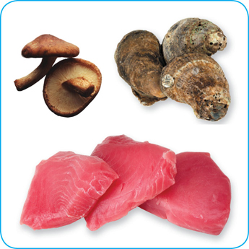
Biological Toxins
Origin:
  Naturally occur in certain plants, mushrooms, and seafood
  Seafood toxins:
  Produced by pathogens found on certain fish
    Tuna, bonito, mahimahi
    Histamine produced when fish is time-temperature abused
  Occur in certain fish that eat smaller fish that have consumed the toxin
    Barracuda, snapper, grouper, amberjack
    Ciguatera toxin is an example
2-12
Notes:
Instructor Notes
Some toxins are naturally associated with certain plants, mushrooms, and seafood. Toxins are a natural part of some fish.
Other toxins, such as histamine, are made by pathogens on the fish when it is time-temperature abused. This can occur in tuna, bonito, mackerel, and mahimahi.
Some fish become contaminated when they eat smaller fish that have eaten a toxin. One of these toxins is the ciguatera toxin. It can be found in barracuda, snapper, grouper, and amberjack. Shellfish, such as oysters, can be contaminated when they eat marine algae that have a toxin.

Slide 26
Biological Toxins
Illness:
  Symptoms and onset times vary with illness
  People will experience illness within minutes
General symptoms:
  Diarrhea or vomiting
  Neurological symptoms
    Tingling in extremities
    Reversal of hot and cold sensations
  Flushing of the face and/or hives
  Difficulty breathing
  Heart palpitations
2-13
Notes:
Instructor Notes
Toxins cannot be destroyed by cooking or freezing. The most important way to prevent a foodborne illness is to purchase plants, mushrooms, and seafood from approved, reputable suppliers. It is also important to control time and temperature when handling raw fish.

Slide 27
Deliberate Contamination of Food
Groups who may attempt to contaminate food:
  Terrorists or activists
  Disgruntled current or former staff
  Vendors
  Competitors
FDA defense tool:
  A.L.E.R.T.
2-14
Notes:
Instructor Notes
So far, you have learned about methods to prevent the accidental contamination of food. But you also must take steps to stop people who are actually trying to contaminate it. This may include the groups listed on the slide.
These people may try to tamper with your food using biological, chemical, or physical contaminants. They may even use radioactive materials. Attacks might occur anywhere in the food supply chain. But they are usually focused on a specific food item, process, or business.
The best way to protect food is to make it as difficult as possible for someone to tamper with it. For this reason, a food defense program should deal with the points in your operation where food is at risk.
The FDA has created a tool that can be used to develop a food defense program. It is based on the acronym A.L.E.R.T. It can be used to help you identify the points in your operation where food is at risk.

Slide 28
Deliberate Contamination of Food
Assure Make sure products received are from safe sources
Look Monitor the security of products in the facility
Employees Know who is in your facility
Reports Keep information related to food defense accessible
Threat Develop a plan for responding to suspicious activity or
a threat to the operation
2-15
Notes:
Instructor Notes
Assure Make sure that products you receive are from safe sources. Supervise product deliveries. Use approved suppliers who practice food defense. Request that delivery vehicles are locked or sealed.
Look Monitor the security of products in the facility. Limit access to prep and storage areas. Locking storage areas is one way to do this. Create a system for handling damaged products. Store chemicals in a secure location. Train staff to spot food defense threats.
Employees Know who is in your facility. Limit access to prep and storage areas. Identify all visitors, and verify credentials. Conduct background checks on staff.
Reports Keep information related to food defense accessible: receiving logs, office files and documents, staff files, and random food defense self-inspections.
Threat Identify what you will do and who you will contact if there is suspicious activity or a threat at your operation. Hold any product you suspect to be contaminated. Contact your regulatory authority immediately. Maintain an emergency contact list.

Slide 29
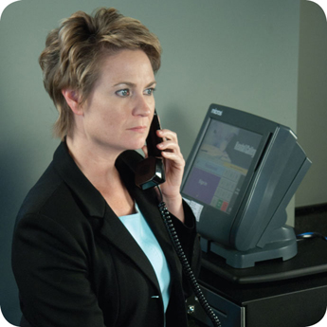
Responding to a Foodborne-Illness Outbreak
  Gather information
    Ask the person for general contact information
    Ask the person to identify the food eaten
    Ask for a description of symptoms
    Ask when the person first got sick
  Notify authorities
    Contact the local regulatory authority if an
    outbreak is suspected
2-16
Notes:
Instructor Notes
Ask the person making the complaint for general contact information and to identify the food that was eaten. Also ask for a description of symptoms and when the person first got sick.
Contact the local regulatory authority if you suspect an outbreak.

Slide 30
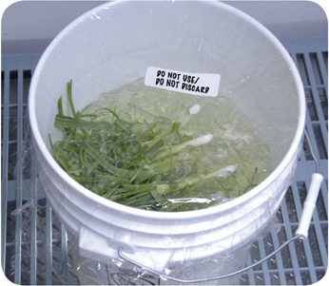
Responding to a Foodborne-Illness Outbreak
  Segregate product
    Set the suspected product aside if any remains
    Include a label with “Do Not Use”
    and “Do Not Discard” on it
  Document the information
    Log information about suspected product
    Include a product description, product date, lot number, sell-by date, and pack size
2-17
Notes:
Instructor Notes
Set the suspected product aside if any remains. Include a label with Do Not Use and Do Not Discard on it, as shown in the photo on the slide.
Log information about the suspected product. This might include a product description, production date, and lot number. The sell-by date and pack size should also be recorded.

Slide 31
Responding to a Foodborne-Illness Outbreak
  Identify staff
    Keep a list of food handlers scheduled at time of incident
    Interview staff immediately
  Cooperate with authorities
    Provide appropriate documentation
  Review procedures
    Determine if standards are being met
    Identify if standards are not working
2-18
Notes:
Instructor Notes
Maintain a list of food handlers scheduled at the time of the suspected contamination. These staff members may be subject to an interview and sampling by investigators. They should also be interviewed immediately by management about their health status.
Cooperate with regulatory authorities in the investigation. Provide appropriate documentation. You may be asked to provide temperature logs, HACCP documents, staff files, etc.
Review food-handling procedures to identify if standards are not being met or procedures are not working.

Slide 33
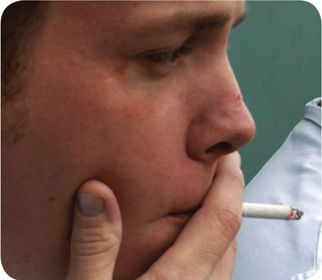
How Food Handlers Can Contaminate Food
Food handlers can contaminate food when they:
  Have a foodborne illness
  Have wounds that contain a pathogen
  Sneeze or cough
  Have contact with a person who is sick
  Touch anything that may contaminate their hands and do not wash them
  Have symptoms such as diarrhea, vomiting, or jaundice—a yellowing of the eyes or skin
3-2
Notes:
Instructor Notes
With some illnesses, a person may infect others before showing any symptoms. For example, a person could spread hepatitis A for weeks before having any symptoms.
With other illnesses, a person may infect others for days or even months after symptoms are gone. Norovirus can be spread for days after symptoms have ended.
Some people carry pathogens and infect others without ever getting sick themselves. These people are called carriers. The bacteria Staphylococcus aureus is carried in the nose of 30 to 50 percent of healthy adults. About 20 to 35 percent of healthy adults carry it on their skin. Food handlers transfer this type of bacteria to food when they touch the infected areas of their bodies and then touch food without washing their hands.

Slide 34
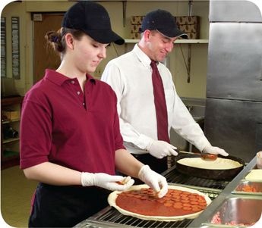
Managing a Personal Hygiene Program
Managers must focus on the following:
  Creating personal hygiene policies
  Training food handlers on personal hygiene policies and retraining them regularly
  Modeling correct behavior at all times
  Supervising food safety practices
  Revising personal hygiene policies when laws or science change
3-3
Notes:
Instructor Notes
Don’t underestimate your role in a personal hygiene program. You have many responsibilities to help make the program work. Some of these are highlighted in the slide.

Slide 35
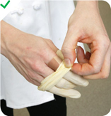
Infected Wounds or Cuts
Infected wounds or cuts:
  Contain pus
  Must be covered to prevent pathogens
  from contaminating food and food-contact surfaces
How a wound is covered depends on
where it is located:
  Cover wounds on the hand or wrist with an
  impermeable cover, (i.e. bandage or finger cot) and
  then a single-use glove
  Cover wounds on the arm with an impermeable cover,
  such as a bandage
  Cover wounds on other parts of the body with a dry,
  tight-fitting bandage
3-4

Slide 36
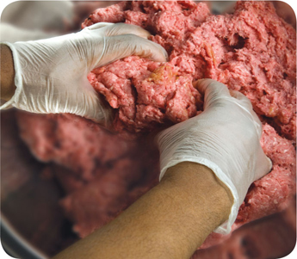
Single-Use Gloves
Single-use gloves:
  Should be used when handling
  ready-to-eat food
    Except when washing produce
    Except when handling ready-to-eat ingredients for a dish that will be cooked
  Must NEVER be used in place
  of handwashing
  Must NEVER be washed and reused
  Must fit correctly
3-5
Notes:
Instructor Notes
Single-use gloves can help keep food safe by creating a barrier between hands and food. Gloves should be worn when handling ready-to-eat food. The exceptions include when washing produce, or when handling ready-to-eat ingredients for a dish that will be cooked to the correct internal temperature.
Hands must be washed before putting on gloves and when changing to a new pair.
Make sure you provide different glove sizes. Gloves that are too big will not stay on. Those that are too small will tear or rip easily.
Some food handlers and customers may be sensitive to latex. Consider providing gloves made from other materials.

Slide 37
Single-Use Gloves
How to use gloves:
  Wash and dry hands before putting gloves on
  Select the correct glove size
  Hold gloves by the edge when putting them on
  Once gloves are on, check for rips or tears
  NEVER blow into gloves
  NEVER roll gloves to make them easier to put on
3-6
Notes:
Instructor Notes
Avoid contaminating gloves when putting them on.

Slide 38
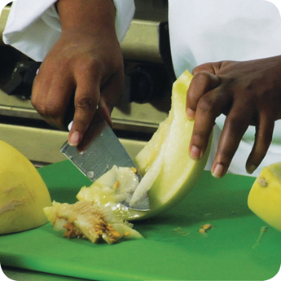
Bare-Hand Contact with Ready-to-Eat Food
Bare-hand contact with ready-to-eat food must be avoided:
  Some jurisdictions allow it but require
    Policies on staff health
    Training in handwashing and personal hygiene practices
  NEVER handle ready-to-eat food with bare hands when you primarily serve a high-risk population
3-7
Notes:
Instructor Notes
Food can become contaminated when it has been handled with bare hands. This is especially true when hands have not been washed correctly or have infected cuts or wounds. For this reason, do not handle ready-to-eat food with bare hands.
Never handle ready-to-eat food with bare hands if you primarily serve a high-risk population.
Some regulatory authorities allow bare-hand contact with ready-to- eat food. If your jurisdiction allows this, you must have specific policies in place about staff health. You must also train staff in handwashing and personal hygiene practices.

Slide 39
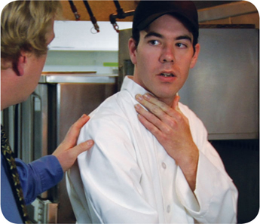
Handling Staff Illnesses
  If:
  The food handler has a sore throat with a fever
Then:
  Restrict the food handler from working with or around food
  Exclude the food handler from the operation if you primarily serve a high-risk population
  A written release from a medical practitioner is required before returning to work
3-8
Notes:
Instructor Notes
You must encourage your staff to report any health problems before they come to work. This includes newly hired staff who haven’t started working yet.
Staff should also let you know immediately if they get sick while working. Your regulatory authority may ask you to prove you have made staff aware of this policy.
When food handlers are sick, you may need to restrict them from working with or around food. Sometimes, you may need to exclude them from working in the operation.

Slide 40

Handling Staff Illnesses
  If:
  The food handler has at least one of these symptoms
  Vomiting
  Diarrhea
  Then:
  Exclude the food handler from the operation
Before returning to work, food handlers who vomited
or had diarrhea must meet one of these requirements
  Have had no symptoms for at least 24 hours
  Have a written release from a medical practitioner
3-9

Slide 41
Handling Staff Illnesses
If:
  The food handler has jaundice
Then:
  Food handlers with jaundice must be reported to the regulatory authority
  Exclude food handlers who’ve had jaundice for less than
  seven days from the operation
  Food handlers must have a written release from a
  medical practitioner and approval from the regulatory authority before returning to work
3-10

Slide 42
Handling Staff Illnesses
If:
  The food handler has been diagnosed with a foodborne illness
  caused by one of these pathogens and has symptoms
    Hepatitis A
    Salmonella Typhi
    Enterohemorrhagic and shiga toxin-producing E. coli
    Norovirus
    Shigella spp.
Then:
  Exclude the food handler from the operation
  Work with the food handler’s medical practitioner and/or the local regulatory authority to decide when the person can go back to work
3-11
Notes:
Instructor Notes
Some food handlers diagnosed with these foodborne illnesses may not experience the usual signs or their symptoms may be over. Work with the local regulatory authority to determine whether the food handler must be excluded from the operation or restricted from working with or around food, and when the exclusion or restriction can be removed.
Remember these are only guidelines, working with your regulatory authority will help you determine the best course of action.

Slide 44
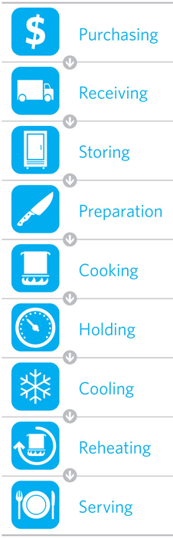
The Flow of Food
To keep food safe throughout the flow of food:
  Prevent cross-contamination
  Prevent time-temperature abuse
4-2
Notes:
Instructor Notes
You are responsible for the safety of the food at every point in this flow. For example, a frozen food might be safe when it leaves the processor’s plant. However, on the way to the supplier’s warehouse, the food might thaw. Once in your operation, the food might not be stored correctly, or it might not be cooked to the correct internal temperature. These mistakes can add up and cause a foodborne illness.

Slide 45
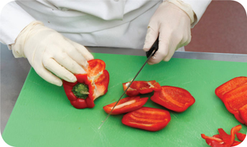
Preventing Cross-Contamination
Separate equipment:
  Use separate equipment for each type of food
Clean and sanitize:
  Clean and sanitize all work surfaces, equipment, and utensils after each task
4-3
Notes:
Instructor Notes
Each type of food should have separate equipment. For example, use one set of cutting boards, utensils, and containers for raw poultry. Use another set for raw meat. Use a third set for produce. Colored cutting boards and utensil handles can help keep equipment separate. The color tells food handlers which equipment to use with each food item. You might use yellow for raw chicken, red for raw meat, and green for produce, as the prep chef is doing in the photo.
Clean and sanitize all work surfaces, equipment, and utensils after each task. When you cut up raw chicken, for example, you cannot get by with just rinsing the equipment. Pathogens such as Salmonella spp. can contaminate food through cross-contamination. To prevent this, you must wash, rinse, and sanitize equipment.

Slide 46
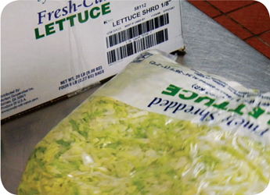
Preventing Cross-Contamination
Prep food at different times:
  Prepare raw meat, fish, and poultry at different times than ready-to-eat food (when using the same prep table)
Buy prepared food:
  Buy food items that do not require much prepping or handling
4-4
Notes:
Instructor Notes
If you need to use the same table to prep different types of food, prep raw meat, fish, and poultry; and ready-to-eat food at different times. You must clean and sanitize work surfaces and utensils between each type of food. For example, by prepping ready-to-eat food before raw food, you can minimize the chance for cross-contamination.
Buy food that doesn’t require much prepping or handling. For example, you could buy precooked chicken breasts or chopped lettuce, as shown in the photo.

Slide 47
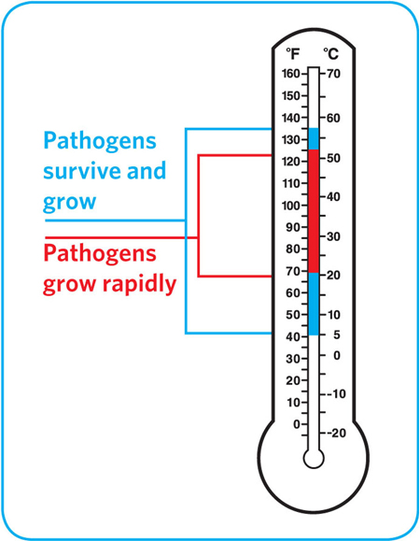
Preventing Time-Temperature Abuse
Time-temperature control:
  Food held in the range of 41°F and 135°F (5°C and 57°C) has been time-temperature abused
  Food has been time-temperature abused whenever it is handled in the following ways
    Cooked to the wrong internal temperature
    Held at the wrong temperature
    Cooked or reheated incorrectly
4-5
Notes:
Instructor Notes
Most foodborne illnesses happen because TCS food has been time-temperature abused. Remember, TCS food has been time-temperature abused any time it remains between 41°F and 135°F (5°C and 57°C). This is called the temperature danger zone because pathogens grow in this range. But most pathogens grow much faster between 70°F and 125°F (21°C and 52°C).
Food is being temperature abused whenever it is handled in the following ways: cooked to the wrong internal temperature, held at the wrong temperature, or cooled or reheated incorrectly.
The longer food stays in the temperature danger zone, the more time pathogens have to grow. To keep food safe, you must reduce the time it spends in this temperature range. If food is held in this range for four or more hours, you must throw it out.

Slide 48
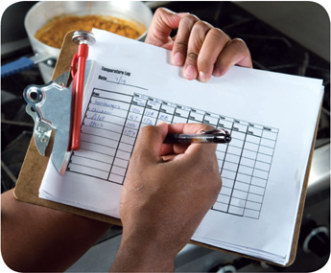
Preventing Time-Temperature Abuse
Avoid time-temperature abuse:
  Monitor time and temperature
  Make sure the correct kinds of thermometers are available
  Regularly record temperatures and the times they are taken
  Minimize the time that food spends in the temperature danger zone
  Take corrective actions if time-temperature standards are not met
4-6
Notes:
Instructor Notes
Learn which food items should be checked, how often, and by whom.
Use timers in prep areas to check how long food is in the temperature danger zone.
A policy limiting the amount of food that can be removed from a cooler when prepping it can limit the time food spends in the temperature danger zone.
Reheating soup that was being held below 135°F (57°C) is an example of a corrective action.

Slide 49
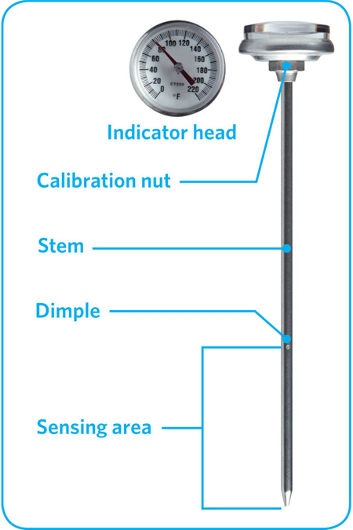
Monitoring Time and Temperature
Bimetallic stemmed thermometer
4-7
Notes:
Instructor Notes
A bimetallic stemmed thermometer can check temperatures from 0˚F to 220˚F (–18˚C to 104˚C).
This thermometer measures temperature through its metal stem. When checking temperatures, insert the stem into the food up to the dimple. You must do this because the sensing area of the thermometer goes from the tip of the stem to the dimple. This trait makes this thermometer useful for checking the temperature of large or thick food. It is usually not practical for thin food, such as hamburger patties.
The calibration nut is used to adjust the thermometer to make it accurate.

Slide 50
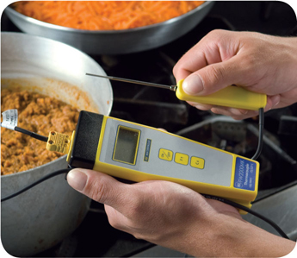
Monitoring Time and Temperature
Thermocouples and thermistors:
  Measure temperature through a metal probe
  Display temperatures digitally
  Come with interchangeable probes
    Immersion probe
    Surface probe
    Penetration probe
    Air probe
  Have a sensing area on the tip of their probe
4-8
Notes:
Instructor Notes
The sensing area on thermocouples and thermistors is on the tip of their probe. This means you don’t have to insert them into the food as far as bimetallic stemmed thermometers to get a correct reading. Thermocouples and thermistors are good for checking the temperature of both thick and thin food.
Thermocouples and thermistors come in several styles and sizes. Many come with different types of probes.
Immersion probes are used to check the temperature of liquids such as soups, sauces, and frying oil.
Surface probes are used to check the temperature of flat cooking equipment such as griddles.
Penetration probes are used to check the internal temperature of food. Small-diameter probes should be used to check the internal temperature of thin food such as meat patties and fish fillets.
Air probes are used to check the temperature inside coolers and ovens.
.

Slide 51
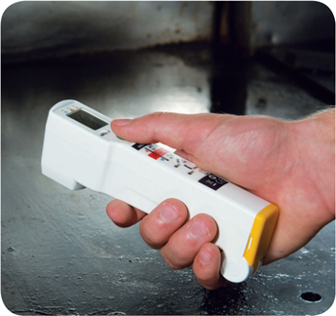
Monitoring Time and Temperature
Infrared (laser) thermometers:
  Used to measure the surface temperature of food and equipment
  Hold as close to the food or equipment as possible
  Remove anything between the thermometer and the food, food package, or equipment
  Follow manufacturers’ guidelines
4-9
Notes:
Instructor Notes
These thermometers cannot measure air temperature or the internal temperature of food.
Hold the thermometer as close as possible to the food, food package, or equipment without touching it. Do NOT take readings through glass or metal, such as stainless steel or aluminum.
Always follow the manufacturers’ guidelines. This should give you the most accurate readings.

Slide 52
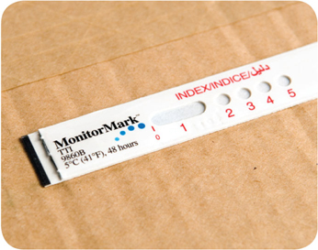
Monitoring Time and Temperature
  Time-temperature indicators (TTI):
  Monitor both time and temperature
  Are attached to packages by the supplier
  A color change appears on the device when
  time-temperature abuse has occurred
Maximum registering tape:
  Indicates the highest temperature reached
  during use
  Used where temperature readings cannot
  be continuously observed
4-10
Notes:
Instructor Notes
Some devices monitor both time and temperature. The time-temperature indicator (TTI) is an example. These tags are attached to packaging by the supplier. A color change appears in the window if the food has been time-temperature abused during shipment or storage. This color change is not reversible, so you know if the food has been abused.
Some suppliers place temperature-recording devices inside their delivery trucks. These devices constantly check and record temperatures. You can check the device during receiving to make sure food was at safe temperatures while it was being shipped.
Other tools are available that can help you monitor temperature. A maximum registering thermometer is one type. This thermometer indicates the highest temperature reached during use and is used where temperature readings cannot be continuously observed. It works well for checking final rinse temperatures of dishwashing machines.

Slide 53
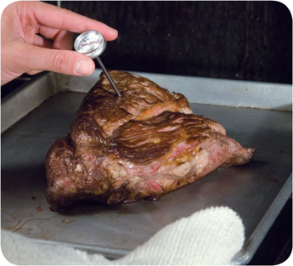
General Thermometer Guidelines
When using thermometers:
  Wash, rinse, sanitize, and air-dry thermometers before and after using them
  Calibrate them before each shift to
  ensure accuracy
  Make sure thermometers used to measure the temperature of food are accurate to
  +/- 2°F or +/- 1°C
  Only use glass thermometers if they are enclosed in a shatterproof casing
4-11
Notes:
Instructor Notes
Thermometers should be washed, rinsed, sanitized, and air-dried before and after each use to prevent cross-contamination. Be sure the sanitizing solution you use is for food-contact surfaces.
Thermometers can lose their accuracy when they are bumped or dropped. It can also happen when they go through severe temperature change. When this happens, the thermometer must be calibrated, or adjusted, to give a correct reading. Make sure your thermometers are accurate by calibrating them regularly. You should do this before each shift. You should also do this before the first delivery arrives. Some thermometers cannot be calibrated and must be replaced. Others will need to be sent back to the manufacturer for calibration. Follow the manufacturer’s directions regarding calibration.
Glass thermometers, such as candy thermometers, can be a physical contaminant if they break. They can only be used when enclosed in a shatterproof casing.

Slide 54
General Thermometer Guidelines
When using thermometers:
  Insert the thermometer stem or
  probe into thickest part of the product
  (usually the center)
  Take more than one reading in different spots
  Wait for the thermometer reading to steady before recording the temperature
4-12
Notes:
Instructor Notes
When checking the temperature of food, insert the probe into the thickest part of the food, as shown in the photo. This is usually in the center. Also take another reading in a different spot. The temperature may vary in different areas. Before recording a temperature, wait for the thermometer reading to steady. Wait at least 15 seconds after you insert the stem or the probe into the food.

Slide 56
Purchasing
and
Receiving
5-2

Slide 57
Receiving and Inspecting
Key drop deliveries:
  Supplier is given after-hours access to the operation
  to make deliveries
  Deliveries must meet the following criteria
    Be inspected upon arrival at the operation
    Be from an approved source
    Have been placed in the correct storage location to
    maintain the required temperature
    Have been protected from contamination in storage
    Is NOT contaminated
    Is honestly presented
5-3
Notes:
Instructor Notes
Some foodservice operations receive food after-hours when they are closed for business. This is often referred to as a key drop delivery.
The supplier is given a key or other access to the operation to make the delivery. Products are then placed in coolers, freezers, and dry storage areas. The delivery must be inspected once you arrive at the operation and meet the criteria identified in the slide.

Slide 58
Receiving and Inspecting
Recalls:
  Identify the recalled food items
  Remove the item from inventory, and place it in a secure and appropriate location
  Store the item separately from food, utensils, equipment, linens, and single-use items
  Label the item in a way that will prevent it from being placed back in inventory
  Inform staff not to use the product
  Refer to the vendor’s notification or recall notice to determine what to do with the item
5-4
Notes:
Instructor Notes
Food items you have received may sometimes be recalled by the manufacturer. This may happen when food contamination is confirmed or suspected. It can also occur when items have been mislabeled or misbranded. Often food is recalled when food allergens have not been identified on the label. Most vendors will notify you of the recall. However, you should also monitor recall notifications made by the FDA and the USDA. Follow the guidelines in the slide when notified of a recall.
Identify the recalled food items by matching information from the recall notice to the item. This may include the manufacturer’s ID, the time the item was manufactured, and the item’s use-by date.
Remove the item from inventory, and place it in a secure and appropriate location. That may be a cooler or dry-storage area.
The recalled item must be stored separately from food, utensils, equipment, linens, and single-use items.
Label the item in a way that will prevent it from being placed back in inventory. Some operations do this by including a Do Not Use and Do Not Discard label on recalled food items. Inform staff not to use the product.
Refer to the vendor’s notification or recall notice for what to do with the item. For example, you might be instructed to throw it out or return it to the vendor.

Slide 59
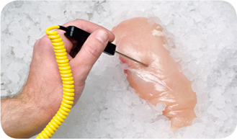
Receiving and Inspecting
Checking the temperature of meat, poultry,
and fish:
  Insert the thermometer stem or probe into the thickest part of the food (usually the center)
5-5

Slide 60
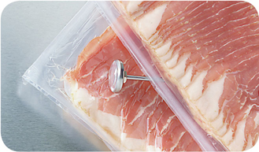
Receiving and Inspecting
Checking the temperature of ROP Food
(MAP, vacuum-packed, and sous vide food):
  Insert the thermometer stem or probe between
  two packages
  As an alternative, fold packaging around the thermometer stem or probe
5-6
Notes:
Instructor Notes
ROP stands for reduced-oxygen packaging. It includes MAP, vacuum-packed, and sous vide food.
It may be possible to check the temperature of bulk food by folding the packaging around the thermometer stem or probe. You must be careful not to puncture the packaging when using this method.

Slide 61
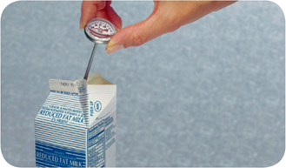
Receiving and Inspecting
Checking the temperature of other packaged food:
  Open the package and insert the thermometer stem or probe into the food
5-7
Notes:
Instructor Notes
When checking the temperature of food by this method, make sure the sensing area of the thermometer stem or probe is fully immersed in the food. It must not touch the package.

Slide 62
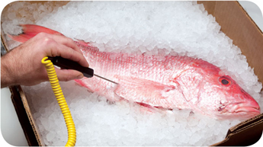
Receiving and Inspecting
Temperature criteria for deliveries:
  Cold TCS food: Receive at 41°F (5°C) or lower, unless otherwise specified
  Live shellfish: Receive oysters, mussels, clams, and scallops at an air temperature of 45°F (7°C) and an internal temperature no greater than 50°F (10°C)
    Once received, the shellfish must be cooled
    to 41°F (5°C) or lower in four hours
  Shucked shellfish: Receive at 45°F (7°C)
  or lower
    Cool the shellfish to 41°F (5°C) or lower in
    four hours
5-8

Slide 63
Receiving and Inspecting
Required documents:
  Farm raised fish
    Must have documentation stating the fish was raised to FDA standards
    Keep documents for 90 days from the sale of the fish
5-9

Slide 64
Storage
5-10

Slide 65
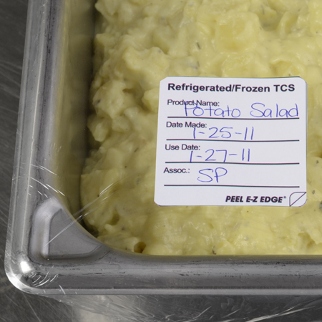
Storage
Labeling food for use on-site:
  All items not in their original containers must be labeled
  Food labels should include the common name of the food or a statement that clearly and accurately identifies it
  It is not necessary to label food if it clearly will not be mistaken for another item
5-11
Notes:
Instructor Notes
Labeling food is important for many reasons. Illnesses have occurred when unlabeled chemicals were mistaken for food such as flour, sugar, and baking powder. Customers have also suffered allergic reactions when food was unknowingly prepped with a food allergen that was not labeled.
It is not necessary to label food if clearly it will not be mistaken for another item. The food must be easily identified by sight

Slide 66
Storage
Labeling food packaged on-site for retail sale:
  Common name of the food or a statement clearly identifying it
  Quantity of the food
  If the item contains two or more ingredients, list the ingredients
  in descending order by weight
  List of artificial colors and flavors in the food including
  chemical preservatives
  Name and place of business of the manufacturer, packer,
  or distributor
  Source of each major food allergen contained in the food
5-12
Notes:
Instructor Notes
Food packaged in the operation that is being sold to customers for use at home must be labeled. The label must include the information on the slide.
Naming the source of each major food allergen contained in the food is not necessary if the source is already part of the common name of the ingredient.

Slide 67

Storage
Date marking:
  Ready-to-eat TCS food must be marked if held for longer than 24 hours
    Date mark must indicate when the food must be sold, eaten, or thrown out
5-13
Notes:
Instructor Notes
Refrigeration slows the growth of most bacteria. Some types, such as Listeria monocytogenes, grow well at refrigeration temperatures. When food is refrigerated for long periods of time, these bacteria can grow enough to cause illness. For this reason, ready-to-eat TCS food must be marked if held for longer than 24 hours. It must indicate when the food must be sold, eaten, or thrown out.

Slide 68

Storage
Date marking:
  Ready-to-eat TCS food can be stored for only seven days if it is held at 41°F (5°C)
  or lower
    The count begins on the day that the food was prepared or a commercial container
    was opened
    For example, potato salad prepared and stored on October 1 would have a discard date of October 7 on the label
    Some operations write the day or date the food was prepared on the label; others write the use-by day or date on the label
5-14

Slide 69
Storage
Date marking:
  If:
  A commercially processed food has a use-by date that is less
  than seven days from the date the container was opened
  Then:
  The container should be marked with this use-by date
  as long as the date is based on food safety
5-15
Notes:
Instructor Notes
Operations have a variety of systems for date marking. Some write the day or date the food was prepped on the label. Others write the use-by day or date on the label.

Slide 70

Storage
Date marking:
  When combining food in a dish with different
  use-by dates, the discard date of the dish should be based on the earliest prepared food
  Consider a shrimp and sausage jambalaya prepared on December 4
    The shrimp has a use-by date of December 8
    The sausage has a use-by date of December 10
    The use-by date of the jambalaya is December 8
5-16

Slide 71
Storage
Temperatures:
  Store TCS food at an internal temperature
  of 41°F (5°C) or lower or 135°F (57°C)
  or higher
  Store frozen food at temperatures that keep it frozen
  Make sure storage units have at least one air temperature measuring device; it must be accurate to +/- 3°F or +/- 1.5°C
  Place the device in the warmest part of refrigerated units, and the coldest part of hot-holding units
5-17
Notes:
Instructor Notes
Pathogens can grow when food is not stored at the correct temperature. Follow the guidelines on the slide to keep food safe.

Slide 72

Storage
Rotate food to use the oldest inventory first:
  One way to rotate products is to follow FIFO
    Identify the food item’s use-by or expiration date
    Store items with the earliest use-by or expiration dates in front of items with later dates
    Once shelved, use those items stored in front first
    Throw out food that has passed its manufacturer’s use-by or expiration date
5-18
Notes:
Instructor Notes
Food must be rotated in storage to maintain quality and limit the growth of pathogens. Food items must be rotated so that those with the earliest use-by or expiration dates are used before items with later dates.
Many operations use the first-in, first-out (FIFO) method to rotate their refrigerated, frozen, and dry food during storage. Here is one way to use the FIFO method.

Slide 73

Storage
Preventing cross-contamination:
  Store all items in designated storage areas
    Store items away from walls and at least
    six inches (15 centimeters) off the floor
    Store single-use items (e.g., sleeve of
    single-use cups, single-use gloves) in
    original packaging
5-19

Slide 74
Storage
Food should be stored in a clean, dry location away from dust and other contaminants:
  To prevent contamination, NEVER store food in these areas
    Locker rooms or dressing rooms
    Restrooms or garbage rooms
    Mechanical rooms
    Under unshielded sewer lines or leaking water lines
    Under stairwells
5-20

Slide 76
General Preparation Practices
Food and color additives:
  Only use additives approved by your local regulatory authority
  NEVER use more additives than are allowed by law
  NEVER use additives to alter the appearance of food
  Do NOT sell produce treated with sulfites before it was received in the operation
  NEVER add sulfites to produce that will be eaten raw
6-2

Slide 77
General Preparation Practices
Present food honestly:
  Do NOT use the following to misrepresent the appearance of food
    Food additives or color additives
    Colored overwraps
    Lights
  Food not presented honestly must be thrown out
6-3
Notes:
Instructor Notes
Food must be offered to customers in a way that does not mislead or misinform them. Customers must be able to judge the true appearance, color, and quality of food.

Slide 78
General Preparation Practices
Corrective actions:
  Food must be thrown out in the following situations
    When it is handled by staff who have been restricted or excluded from the operation due to illness
    When it is contaminated by hands or bodily fluids from the nose or mouth
    When it has exceeded the time and temperature requirements designed to keep food safe
6-4
Notes:
Instructor Notes
• Food that has become unsafe must be thrown out unless it can be safely reconditioned. All food—especially ready-to-eat food—must be thrown out in the situations highlighted in the slide.
• Sometimes food can be restored to a safe condition. This is called reconditioning. For example, a hot food that has not been held at the correct temperature may be reheated if it has not been in the temperature danger zone for more than two hours.

Slide 79

Prepping Specific Food
Produce:
  Produce can be washed in water containing ozone to sanitize it
    Check with your local regulatory authority
  When soaking or storing produce in standing water or an ice-water slurry, do NOT mix
    Different items
    Multiple batches of the same item
6-5
Notes:
Instructor Notes
Certain chemicals may be used to wash fruits and vegetables. Also, produce can be treated by washing it in water containing ozone. This treatment helps control pathogens. Check your local regulatory requirements.

Slide 80

Prepping Specific Food
Ice:
  NEVER use ice as an ingredient if it was used to keep food cold
  Transfer ice using clean and sanitized containers and scoops
  NEVER hold ice in containers that held chemicals or raw meat, seafood, or poultry
6-6
Notes:
Instructor Notes
Make ice from water that is safe to drink.
Never use ice as an ingredient if it was used to keep food cold. For example, if ice is used to cool food on a salad bar, it cannot then be used in drinks.

Slide 81
Prepping Specific Food
Ice:
  Store ice scoops outside ice machines in a clean, protected location
  NEVER use a glass to scoop ice or touch ice with hands
6-7

Slide 82

Preparation Practices That Have Special Requirements
You need a variance if prepping food in these ways:
  Packaging fresh juice on-site for sale at a later time, unless the juice has a warning label
  Smoking food to preserve it but not to
  enhance flavor
  Using food additives or components to preserve or alter food so it no longer needs time and temperature control for safety
  Curing food
6-8
Notes:
Instructor Notes
You will need a variance when prepping food in certain ways. A variance is a document issued by your regulatory authority that allows a regulatory requirement to be waived or changed.
When applying for a variance, your regulatory authority may require you to submit a HACCP plan. The plan must account for any food safety risks related to the way you plan to prep the food item.

Slide 83

Preparation Practices
You need a variance if prepping food in these ways:
  Packaging food using a reduced-oxygen packaging (ROP) method
  Sprouting seeds or beans
  Offering live shellfish from a display tank
  Custom-processing animals for personal use (i.e. dressing a deer)
6-9
Notes:
Instructor Notes
Clostridium botulinum and Listeria monocytogenes are risks to food packaged using a reduced-oxygen packaging method. This includes MAP, vacuum-packed and sous vide foods.

Slide 84

Cooking Requirements for Specific Food
Minimum internal cooking temperature:
165°F (74°C) for 15 seconds
  Poultry—whole or ground chicken, turkey, or duck
  Stuffing made with fish, meat, or poultry
  Stuffed meat, seafood, poultry, or pasta
  Dishes that include previously cooked, TCS ingredients
6-10

Slide 85

Cooking Requirements for Specific Food
Minimum internal cooking temperature:
155°F (68°C) for 15 seconds
  Ground meat—beef, pork, and other meat
  Injected meat—including brined ham and flavor-injected roasts
  Mechanically tenderized meat
  Ratites including ostrich and emu
  Ground seafood—including chopped or minced seafood
  Shell eggs that will be hot-held for service
6-11

Slide 86

Cooking Requirements for Specific Food
Minimum internal cooking temperature:
145°F (63°C) for 15 seconds
  Seafood—including fish, shellfish, and crustaceans
  Steaks/chops of pork, beef, veal, and lamb
  Commercially raised game
  Shell eggs that will be served immediately
6-12

Slide 87

Cooking Requirements for Specific Food
Minimum internal cooking temperature:
145°F (63°C) for four minutes
  Roasts of pork, beef, veal, and lamb
  Alternate cooking times/temperatures
    130°F (54°C) 112 minutes
    131°F (55°C) 89 minutes
    133°F (56°C) 56 minutes
    135°F (57°C) 36 minutes
    136°F (58°C) 28 minutes
    138°F (59°C) 18 minutes
    140°F (60°C) 12 minutes
    142°F (61°C) 8 minutes
    144°F (62°C) 5 minutes
6-13
Notes:
Instructor Notes
Roasts may be cooked to these alternate cooking times and temperatures depending on the type of roast and oven used:
130°F (54°C) 112 minutes
131°F (55°C) 89 minutes
133°F (56°C) 56 minutes
135°F (57°C) 36 minutes
136°F (58°C) 28 minutes
138°F (59°C) 18 minutes
140°F (60°C) 12 minutes
142°F (61°C) 8 minutes
144°F (62°C) 5 minutes

Slide 88

Cooking Requirements for Specific Food
Minimum internal cooking temperature:
135°F (57°C)
  Fruit, vegetables, grains (rice, pasta), and legumes (beans, refried beans) that will be hot-held for service
6-14

Slide 89

Partial Cooking During Preparation
If partially cooking meat, seafood, poultry, or eggs or dishes containing these items:
  NEVER cook the food longer than
  60 minutes during initial cooking
  Cool the food immediately after
  initial cooking
  Freeze or refrigerate the food after cooling
  Heat the food to at least 165˚F (74˚C) for 15 seconds before selling or serving
  Cool the food if it will not be served immediately or held for service
6-15
Notes:
Instructor Notes
Some operations partially cook food during prep and then finish cooking it just before service. You must follow the steps in the slide if you plan to partially cook meat, seafood, poultry, or eggs; or dishes containing these items.
Your local regulatory authority may require you to have written procedures that explain how the food cooked by this process will be prepped and stored. These procedures must be approved by the regulatory authority and describe the following:
How the requirements will be monitored and documented
Which corrective actions will be taken if requirements are not met
How these food items will be marked after initial cooking to indicate that they need further cooking
How these food items will be separated from ready-to-eat food during storage, once initial cooking is complete

Slide 90

Consumer Advisories
If your menu includes raw or undercooked TCS items, you must:
  Note it on the menu next to the items
    Asterisk the item
    Place a footnote at the menu bottom indicating the item is raw, undercooked, or contains raw or undercooked ingredients
  Advise customers who order this food of the increased risk of foodborne illness
    Post a notice in the menu
    Provide this information using brochures, table tents, or signs
6-16
Notes:
Instructor Notes
If your menu includes TCS items that are raw or undercooked, you must note it on the menu next to these items. This can be done by placing an asterisk next to the item that points customers to a footnote at the bottom of the menu. The footnote must include a statement that indicates the item is raw or undercooked, or contains raw or undercooked ingredients.
You must advise customers who order food that is raw or undercooked of the increased risk of foodborne illness. You can do this by posting a notice in your menu. You can also provide this information using brochures, table tents, signs, or other written methods.

Slide 91

Consumer Advisories
The FDA advises against offering these items on a children’s menu if they are raw or undercooked:
  Meat
  Poultry
  Seafood
  Eggs
6-17
Notes:
Instructor Notes
The Food and Drug Administration (FDA) advises against offering raw or undercooked meat, poultry, seafood, or eggs on a children’s menu. This is especially true for undercooked ground beef, which may be contaminated with enterohemorrhagic and shiga toxin-producing E. coli O157:H7.

Slide 92

Operations That Mainly Serve High-Risk Populations
NEVER serve:
  Raw seed sprouts
  Raw or undercooked eggs, meat, or seafood
    Over-easy eggs
    Raw oysters on the half shell
    Rare hamburgers
6-18

Slide 93
Storing Food for Further Cooling
When storing food for further cooling:
  Loosely cover food containers before storing them
  Food can be left uncovered if protected from contamination
    Storing uncovered containers above other food, especially raw seafood, meat, and poultry, will help prevent cross-contamination
6-19
Notes:
Instructor Notes
Loosely cover food containers before storing them. Food can be left uncovered if stored in a way that prevents contaminants from getting into it. Storing uncovered containers above other food, especially raw seafood, meat, and poultry, will help prevent cross-contamination.

Slide 94

Reheating Food
Food reheated for immediate service:
  Can be reheated to any temperature if it was cooked and cooled correctly
Food reheated for hot-holding:
  Must be reheated to an internal temperature of 165°F (74°C) for 15 seconds within two hours
  Reheat commercially processed and packaged ready-to-eat food to an internal temperature of at least 135°F (57°C)
6-20
Notes:
Instructor Notes
These guidelines apply to all heating methods, such as ovens or microwave ovens.

Slide 96

Holding Food Without Temperature Control
Cold food can be held without temperature control for up to six hours if:
  It was held at 41°F (5°C) or lower before removing it from refrigeration
  It does not exceed 70°F (21°C) during service
    Throw out food that exceeds this temperature
  It has a label specifying
    Time it was removed from refrigeration
    Time it must be thrown out
  It is sold, served, or thrown out within six hours
7-2
Notes:
Instructor Notes
If your operation displays or holds TCS food without temperature control, it must do so under certain conditions. The conditions for holding cold food are different from those for holding hot food. Before using time as a method of control, check with your local regulatory authority for specific requirements.
For cold food, label the food with the time you removed it from refrigeration and the time you must throw it out. The discard time on the label must be six hours from the time you removed the food from refrigeration.
For example, if you remove potato salad from refrigeration at 3:00 p.m. to serve at a picnic, the discard time on the label should be 9:00 p.m. This equals six hours from the time you removed it from refrigeration.

Slide 97

Holding Food Without Temperature Control
Hot food can be held without temperature control for up to four hours if:
  It was held at 135°F (57°C) or higher before removing it from temperature control
  It has a label specifying when the item must be thrown out
  It is sold, served, or thrown out within four hours
7-3
Notes:
Instructor Notes
Before using time as a method of control, check with your local regulatory authority for specific requirements.
For hot food, the discard time on the label must be four hours from the time you removed the food from temperature control.

Slide 98

Preset Tableware
If you preset tableware:
  Prevent it from being contaminated
    Wrap or cover the items
Table settings do not need to be wrapped or covered if extra settings:
  Are removed when guests are seated
  Are cleaned and sanitized after guests have left
7-4
Notes:
Instructor Notes
Table settings do not need to be wrapped or covered if extra settings meet these requirements:
They are removed when guests are seated
If they remain on the table, they are cleaned and sanitized after guests have left

Slide 99

Re-serving Food
NEVER re-serve:
  Food returned by one customer to another customer
  Uncovered condiments
  Uneaten bread
  Plate garnishes
Generally, only unopened, prepackaged food in good condition can be re-served:
  Condiment packets
  Wrapped crackers or breadsticks
7-5
Notes:
Instructor Notes
You must protect condiments from contamination. Serve them in their original containers or in containers designed to prevent contamination. Offering condiments in individual packets or portions can also help keep them safe. Never re-serve uncovered condiments. Do not combine leftover condiments with fresh ones. Throw away opened portions or dishes of condiments after serving them to customers. Salsa, butter, mayonnaise, and ketchup are examples.
Change linens used in bread baskets after each customer.
In general, only unopened prepackaged food can be re-served. That includes condiment packets, wrapped crackers or breadsticks, and bottles of ketchup and mustard.

Slide 100
Labeling Bulk Food in Self-Service Areas
When labeling bulk food in self-service areas:
  Make sure the label is in plain view of the customer
  Include the manufacturer or processor label provided with the food
    As an alternative, provide the information using a card, sign, or other labeling method
7-6

Slide 101
Labeling Bulk Food in Self-Service Areas
A label is not needed for bulk unpackaged food, such as bakery products, if:
  The product makes no claim regarding health or nutrient content
  No laws requiring labeling exist
  The food is manufactured or prepared on the premises
  The food is manufactured or prepared at another regulated food operation or processing plant owned by the same person
7-7
Notes:
Instructor Notes
Bulk unpackaged food, such as bakery products and unpackaged food portioned for customers, does not need to be labeled if it meets the conditions identified in the slide.

Slide 102

Off-Site Service
When delivering food off-site:
  Use insulated, food-grade containers designed to stop food from mixing, leaking, or spilling
  Clean the inside of delivery vehicles regularly
  Check internal food temperatures
  Label food with a use-by date and time, and reheating and service instructions
7-8
Notes:
Instructor Notes
Delays from the point of preparation to the point of service increase the risk that food will be exposed to contamination or time-temperature abuse.
At the service site, use appropriate containers or equipment to hold food at the correct temperature.
Check internal food temperatures. If containers or delivery vehicles are not holding food at the correct temperature, reevaluate the length of the delivery route or the efficiency of the equipment being used.

Slide 103

Off-Site Service
When delivering food off-site:
  Make sure the service site has the
  correct utilities
    Safe water for cooking, dishwashing,
    and handwashing
    Garbage containers stored away from
    food-prep, storage, and serving areas
  Store raw meat, poultry, and seafood, and
  ready-to-eat items separately
7-9

Slide 104

Vending Machines
To keep vended food safe:
  Check product shelf life daily
    Refrigerated food prepped on-site and not sold in seven days must be thrown out
  Keep TCS food at the correct temperature
  Dispense TCS food in its original container
  Wash and wrap fresh fruit with edible peels before putting it in the machine
7-10
Notes:
Instructor Notes
Handle food prepped and packaged for vending machines with the same care as any other food served to customers. Vending operators should protect food from contamination and time-temperature abuse during transport, delivery, and service.
Check product shelf life daily. Products often have a code date, such as an expiration or a use-by date. If the date has expired, throw out the food immediately. Throw out refrigerated food prepped on-site if not sold within seven days of preparation.
Keep TCS food at the correct temperature. It should be held at 41°F (5°C) or lower, or at 135°F (57°C) or higher. These machines must have controls that prevent TCS food from being dispensed if the temperature stays in the danger zone for a specified amount of time. This food must be thrown out

Slide 106
Food Safety Management Systems
Food safety management system:
  Group of practices and procedures intended to prevent foodborne illness
  Actively controls risks and hazards throughout the flow of food
8-2

Slide 107




Food Safety Programs
These are the foundation of a food safety management system:
Personal hygiene program
Food safety training program
Supplier selection and specification program
Quality control and
assurance program
8-3
Notes:
Instructor Notes
Having food safety programs already in place gives you the foundation for your system. The principles presented in the ServSafe program are the basis of these programs.

Slide 108




Food Safety Programs
These are the foundation of a food safety management system:
Cleaning and
sanitation program
Standard operating
procedures (SOPs)
Facility design and equipment maintenance program
Pest control program
8-4
Notes:
Instructor Notes
Having food safety programs already in place gives you the foundation for your system. The principles presented in the ServSafe program are the basis of these programs.

Slide 109
Active Managerial Control
Focuses on controlling the five most common risk factors for foodborne illness:
  Purchasing food from unsafe sources
  Failing to cook food adequately
  Holding food at incorrect temperatures
  Using contaminated equipment
  Practicing poor personal hygiene
8-5
Notes:
Instructor Notes
There are many ways to achieve active managerial control in the operation. According to the Food and Drug Administration (FDA), you can use simple tools such as training programs, manager supervision, and the incorporation of SOPs. Active Managerial Control can also be achieved through more complex solutions such as a HACCP Program.
Monitoring is critical to the success of active managerial control. Food will be safe if managers monitor critical activities in the operation.
Managers must also take the necessary corrective action when required. They must also verify that the actions taken to control the risk factors for foodborne illness are actually working.

Slide 110
Active Managerial Control
There are many ways to achieve active managerial control in the operation:
  Training programs
  Manager supervision
  Incorporation of standard operating procedures (SOPs)
  HACCP
  These are critical to the success of active managerial control:
  Monitoring critical activities in the operation
  Taking the necessary corrective action when required
  Verifying that the actions taken control the risks factors
8-6
Notes:
Instructor Notes
There are many ways to achieve active managerial control in the operation. According to the Food and Drug Administration (FDA), you can use simple tools such as training programs, manager supervision, and the incorporation of SOPs. Active Managerial Control can also be achieved through more complex solutions such as a HACCP Program.
Monitoring is critical to the success of active managerial control. Food will be safe if managers monitor critical activities in the operation.
Managers must also take the necessary corrective action when required. They must also verify that the actions taken to control the risk factors for foodborne illness are actually working.

Slide 111

Active Managerial Control
The FDA provides recommendations for controlling the common risk factors for foodborne illness:
  Demonstration of knowledge
  Staff health controls
  Controlling hands as a vehicle of contamination
  Time and temperature parameters for controlling pathogens
  Consumer advisories
8-7
Notes:
Instructor Notes
Demonstration of knowledge: As a manager, you must be able to show that you know what to do to keep food safe. Becoming certified in food safety is one way to show this.
Staff health controls: Procedures must be put in place to make sure staff are practicing personal hygiene. For example, staff must know that they must report illnesses and illness symptoms to management.
Controlling hands as a vehicle of contamination: Controls must be put in place to prevent bare-hand contact with ready-to-eat food. This might include requiring the use of tongs to handle ready-to-eat food.
Time and temperature parameters for controlling pathogens: Procedures must be put in place to limit the time food spends in the temperature danger zone. Requiring food handlers to check the temperature of food being hot-held every two hours is an example.
Consumer advisories: Notices must be provided to customers if you serve raw or undercooked menu items. These notices must include a statement about the risks of eating these foods.

Slide 112
HACCP
The HACCP approach:
  HACCP is based on identifying significant biological, chemical, or physical hazards at specific points within
  a product’s flow through an operation
  Once identified, hazards can be prevented, eliminated, or reduced to safe levels
8-8
Notes:
Instructor Notes
There are many systems you can implement to achieve active managerial control of foodborne illness risk factors. Hazard Analysis Critical Control Point (HACCP) is one such system. HACCP (pronounced HASS-ip) is based on identifying significant biological, chemical, or physical hazards at specific points within a product’s flow. Once identified, the hazards can be prevented, eliminated, or reduced to safe levels.

Slide 113
HACCP
To be effective, a HACCP system must be based on a written plan:
  It must be specific to each facility’s menu, customers, equipment, processes, and operations
  A plan that works for one operation may not work for another
8-9
Notes:
Instructor Notes
Each HACCP plan is unique, a plan that works for one operation may not work for another.

Slide 114
The 7 HACCP Principles
The seven HACCP principles:
  Conduct a hazard analysis
  Determine critical control points (CCPs)
  Establish critical limits
  Establish monitoring procedures
  Identify corrective actions
  Verify that the system works
  Establish procedures for record keeping and documentation
8-10
Notes:
Instructor Notes
In general terms, the HACCP principles can be broken into three groups:
Principles 1 and 2 help you identify and evaluate your hazards.
Principles 3, 4, and 5 help you establish ways for controlling those hazards.
Principles 6 and 7 help you maintain the HACCP plan and system and verify its effectiveness.

Slide 115

The 7 HACCP Principles
Principle 1: Conduct a hazard analysis
  Identify potential hazards in the food served by looking at how it
  is processed
  Identify TCS food items and determine where hazards are likely to occur for each one; look for biological, chemical, and physical contaminants
8-11
Notes:
Instructor Notes
Here is a real-world example showing the efforts of Enrico’s, an Italian restaurant, as it implements a HACCP program:
The management team at Enrico’s decided to implement a HACCP program. They began by analyzing their hazards.
The team noted that many of their dishes are received, stored, prepared, cooked, and served the same day. The most popular of these items was the spicy charbroiled chicken breast.
The team determined that bacteria were the most likely hazard to food prepared this way.

Slide 116

The 7 HACCP Principles
Principle 2: Determine critical control points (CCPs)
  Find points in the process where identified hazards can be prevented, eliminated, or reduced to safe levels—these are the CCPs
  Depending on the process, there may be more than one CCP
8-12
Notes:
Instructor Notes
Here is a real-world example showing the efforts of Enrico’s, an Italian restaurant, as it implements a HACCP program:
Enrico’s management identified cooking as the CCP for food prepared and cooked for immediate service. This included the chicken breasts.
These food items must be handled correctly throughout the flow of food. However, correct cooking is the only step that will eliminate or reduce bacteria to safe levels.
Because the chicken breasts were prepared for immediate service, cooking was the only CCP identified.

Slide 117

The 7 HACCP Principles
Principle 3: Establish critical limits
  For each CCP, establish minimum or maximum limits
  These limits must be met to
    Prevent or eliminate the hazard
    Reduce it to a safe level
Critical
Limit
8-13
Notes:
Instructor Notes
Here is a real-world example showing the efforts of Enrico’s, an Italian restaurant, as it implements a HACCP program:
With cooking identified as the CCP for Enrico’s chicken breasts, a critical limit was needed. Management determined that the critical limit would be cooking the chicken to a minimum internal temperature of 165°F (74°C) for 15 seconds.
They decided that the critical limit could be met by cooking chicken breasts in the broiler for 16 minutes.

Slide 118

The 7 HACCP Principles
Principle 4: Establish monitoring procedures
  Determine the best way to check critical limits
    Make sure they are consistently met
  Identify who will monitor them and how often
8-14
Notes:
Instructor Notes
Here is a real-world example showing the efforts of Enrico’s, an Italian restaurant, as it implements a HACCP program:
At Enrico’s, each charbroiled chicken breast is cooked to order. The team decided to check the critical limit by inserting a clean and sanitized thermocouple probe into the thickest part of each chicken breast.
The grill cook must check the temperature of each chicken breast after cooking. Each chicken breast must reach the minimum internal temperature of 165°F (74°C) for 15 seconds.

Slide 119

The 7 HACCP Principles
Principle 5: Identify corrective actions
  Identify steps that must be taken when a critical limit is not met
  Determine these steps in advance
8-15
Notes:
Instructor Notes
Here is a real-world example showing the efforts of Enrico’s, an Italian restaurant, as it implements a HACCP program:
If the chicken breast has not reached its critical limit within the 16-minute cook time, the grill cook at Enrico’s must keep cooking the chicken breast until it has reached it.
This and all other corrective actions are noted in the temperature log.

Slide 120

The 7 HACCP Principles
Principle 6: Verify that the system works
  Determine if the plan is working as intended
  Evaluate the plan on a regular basis using
    Monitoring charts
    Records
    Hazard analysis
  Determine if your plan prevents, reduces, or eliminates identified hazards
8-16
Notes:
Instructor Notes
Here is a real-world example showing the efforts of Enrico’s, an Italian restaurant, as it implements a HACCP program:
Enrico’s management team performs HACCP checks once per shift. They make sure that critical limits were met and appropriate corrective actions were taken when needed.
They also check the temperature logs on a weekly basis to identify patterns. This helps to determine if processes or procedures need to be changed. For example, over several weeks they noticed problems toward the end of each week. The chicken breasts often failed to meet the critical limit. The appropriate corrective action was being taken.
Management discovered that Enrico’s received chicken shipments from a different supplier on Thursdays. This supplier provided a six-ounce chicken breast. Enrico’s chicken specifications listed a four-ounce chicken breast. Management worked with the supplier to ensure they received four-ounce breasts. The receiving procedures were changed to include a weight check.

Slide 121

The 7 HACCP Principles
Principle 7: Establish procedures for record keeping and documentation
Keep records for these actions:
  Monitoring activities
  Corrective actions
  Validating equipment (checking for good working condition)
  Working with suppliers (invoices, specifications, etc.)
8-17
Notes:
Instructor Notes
Maintain your HACCP plan and keep all documentation created when developing it.
Here is a real-world example showing the efforts of Enrico’s, an Italian restaurant, as it implements a HACCP program:
Enrico’s management team determined that time-temperature logs should be kept for three months. Receiving invoices would be kept for 60 days. The team used this documentation to support and revise their HACCP plan.

Slide 122
HACCP
These specialized processing methods require a variance and may require a HACCP plan:
  Smoking food as a method to preserve it (but not to enhance flavor)
  Using food additives or components such as vinegar to preserve or alter food so it no longer requires time and temperature control for safety
  Curing food
  Custom-processing animals
8-18
Notes:
Instructor Notes
Some food processes are highly specialized and can be a serious health risk if specific procedures are not followed. Typically these processes are carried out at processing plants.
A variance from the regulatory authority will be required before processing food this way. A variance is a document that allows a requirement to be waived or changed.
A HACCP plan may also be required if the processing method carries a higher risk of causing a foodborne illness. There may also be dangers unique to these processes that are best addressed by HACCP.

Slide 123
HACCP
These specialized processing methods require a variance and may require a HACCP plan:
  Packaging food using ROP methods including
    MAP
    Vacuum-packed
    Sous vide
  Treating (e.g. pasteurizing) juice on-site and packaging it for later sale
  Sprouting seeds or beans
8-19
Notes:
Instructor Notes
Always check with your local regulatory authority to see if a variance is also required when prepping food in these ways.
A HACCP plan is required when packaging food using reduced-oxygen packaging (ROP) methods. This includes MAP, vacuum-packed, and sous vide food. Clostridium botulinum and Listeria monocytogenes are risks to food packaged in these ways.

Slide 125

Installing and Maintaining Equipment
Once equipment has been installed:
  It must be maintained regularly
  Only qualified people should maintain it
  Set up a maintenance schedule with your supplier or manufacturer
  Check equipment regularly to make sure it is working correctly
9-2

Slide 126

Dishwashing Machines
Dishwashers must be installed:
  So they are reachable and conveniently located
  In a way that keeps utensils, equipment, and other food-contact services from becoming contaminated
  Following manufacturer’s instructions
9-3
Notes:
Instructor Notes
Always follow the manufacturer’s instructions when installing, operating, and maintaining dishwashers.

Slide 127

Garbage
  Designated storage areas:
  Store waste and recyclables separately from food and food-contact surfaces
  Storage must not create a nuisance or a public health hazard
9-4
Notes:
Instructor Notes
Waste and recyclables must be stored separately from food and food-contact surfaces. The storage of these items must not create a nuisance or a public health hazard.

Slide 128
Emergencies That Affect the Facility
Imminent health hazard:
  A significant threat or danger to health
  Requires immediate correction or closure to prevent injury
Possible imminent health hazards:
  Electrical power outages
  Fire
  Flood
  Sewage backups
9-5
Notes:
Instructor Notes
Certain crises can affect the safety of the food you serve. Common crisis’ include electrical power outages, fire, flooding, and sewage backups. Local regulatory authorities consider these to be imminent health hazards. An imminent health hazard is a significant threat or danger to health that requires immediate correction or closure to prevent injury.
Temperature control: Power failures and refrigeration breakdowns can threaten your ability to control the temperature of TCS food, which can result in the growth of pathogens.
Physical security: Unauthorized people inside a facility are a risk to food safety. This is especially true when they can access storage and processing areas. Also, acts of nature can weaken a facility’s security.
Drinkable water supply: Threats to the drinkable water supply must also be considered. Broken water mains and breakdowns at water treatment facilities are a risk to the safety of food. Terrorist contamination of the water supply could also be a threat.

Slide 129
Emergencies That Affect the Facility
How to respond to a crisis affecting the facility:
  Determine if there is a significant risk to the safety or security of your food
  If the risk is significant
    Stop service
    Notify the local regulatory authority
  Decide how to correct the problem
    Establish time-temperature control
    Clean and sanitize surfaces
    Verify water is drinkable
    Reestablish physical security of the facility
9-6

Slide 131
Guidelines for the Effective Use of Sanitizers
Chlorine
Water temperature | ≥100°F (38°C) | ≥75°F (24°C)
Water pH | ≤10 | ≤8
Water hardness | As per manufacturer’s recommendations
Sanitizer concentration range | 50–99 ppm | 50–99 ppm
Sanitizer contact time | ≥7 sec | ≥7 sec
10-2

Slide 132
Guidelines for the Effective Use of Sanitizers
 | Iodine | Quats
Water temperature | 68°F (20°C) | 75°F (24°C)
Water pH | ≤5 or as per manufacturer’s recommendations | As per manufacturer’s recommendations
Water hardness | As per manufacturer’s recommendations | ≤500 ppm or as per manufacturer’s recommendations
Sanitizer concentration range | 12.5–25 ppm | As per manufacturer’s recommendations
Sanitizer contact time | ≥30 sec | ≥30 sec
10-3

Slide 133





How and When to Clean and Sanitize
How to clean and sanitize:
Scrape or remove food bits from
the surface
Wash the surface
Rinse the surface
Sanitize the surface
Allow the surface to air-dry
10-4
Notes:
Instructor Notes
All surfaces must be cleaned and rinsed. This includes walls, storage shelves, and garbage containers. However, any surface that touches food, such as knives, stockpots, cutting boards, or prep tables, must be cleaned and sanitized.
Scrape or remove food bits from the surface. Use the correct cleaning tool such as a nylon brush or pad, or a cloth towel.
Wash the surface. Prepare the cleaning solution with an approved detergent. Wash the surface with the correct cleaning tool such as a cloth towel.
Rinse the surface. Use clean water. Rinse the surface with the correct cleaning tool such as a cloth towel.
Sanitize the surface. Use the correct sanitizing solution. Prepare the concentration per manufacturer requirements. Use the correct tool, such as a cloth towel, to sanitize the surface. Make sure the entire surface has come in contact with the sanitizing solution.
Allow the surface to air-dry.

Slide 134

How and When to Clean and Sanitize
Cleaning and sanitizing stationary equipment:
  Unplug the equipment
  Take the removable parts off the equipment
    Wash, rinse, and sanitize them by hand or run the parts through a dishwasher if allowed
  Scrape or remove food from the equipment surfaces
  Wash the equipment surfaces
10-5
Notes:
Instructor Notes
Equipment manufacturers will usually provide instructions for cleaning and sanitizing stationary equipment, such as a slicer.
Unplug the equipment.
Take the removable parts off the equipment. Wash, rinse, and sanitize them by hand. You can also run the parts through a dishwasher if allowed.
Scrape or remove food from the equipment surfaces.
Wash the equipment surfaces. Use a cleaning solution prepared with an approved detergent. Wash the equipment with the correct cleaning tool such as a nylon brush or pad, or a cloth towel.

Slide 135
How and When to Clean and Sanitize
Cleaning and sanitizing stationary equipment:
  Rinse the equipment surfaces with clean water
  Sanitize the equipment surfaces
    Make sure the sanitizer comes in contact with each surface
  Allow all surfaces to air-dry
  Put the unit back together
10-6
Notes:
Instructor Notes
Rinse the equipment surfaces with clean water. Use a cloth towel or other correct tool.
Sanitize the equipment surfaces. The food handler in the photo is sanitizing the surfaces of a slicer. Make sure the sanitizer comes in contact with each surface. The concentration of the sanitizer must meet requirements.
Allow all surfaces to air-dry.
Put the unit back together.

Slide 136
How and When to Clean and Sanitize
Clean-in-place equipment:
  Equipment holding and dispensing TCS food must be cleaned and sanitized every day unless otherwise indicated by the manufacturer
  Check local regulatory requirements
10-7
Notes:
Instructor Notes
Some pieces of equipment, such as soft-serve yogurt machines, are designed to have cleaning and sanitizing solutions pumped through them. Since many of them hold and dispense TCS food, they must be cleaned and sanitized every day unless otherwise indicated by the manufacturer. You should also check your local regulatory requirements.

Slide 137

Manual Dishwashing
Setting up a three-compartment sink:
  Clean and sanitize each sink and drain board
  Fill the first sink with detergent and water at least 110°F (43°C)
  Fill the second sink with clean water
  Fill the third sink with water and sanitizer to the correct concentration
  Provide a clock with a second hand to let food handlers know how long items have been in the sanitizer
10-8

Slide 138
Cleaning and Sanitizing in the Operation
Cleaning up after people who get sick:
  Diarrhea and vomit in the operation must be cleaned up correctly
    It can carry Norovirus, which is highly contagious
  Correct cleanup can prevent food from becoming
  contaminated and keep others from getting sick
10-9
Notes:
Instructor Notes
If a person has diarrhea or vomits in the operation, these spills must be cleaned up the correct way. Vomit and diarrhea can carry Norovirus, which is highly contagious. Correct cleanup can prevent food from becoming contaminated. It will also keep others from getting sick. The way you clean up these substances is different from the way you clean other items in the operation.

Slide 139
Cleaning and Sanitizing in the Operation
Consider the following when developing a plan for cleaning up vomit and diarrhea:
  How you will contain liquid and airborne substances, and remove them from the operation
  How you will clean, sanitize, and disinfect surfaces
  When to throw away food that may have been contaminated
  What equipment is needed to clean up these substances, and how it will be cleaned and disinfected after use
  When a food handler must wear personal protective equipment
10-10
Notes:
Instructor Notes
There are several things to think about when developing a plan for cleaning up vomit and diarrhea.
How you will contain liquid and airborne substances, and remove
them from the operation
How you will clean, sanitize, and disinfect surfaces
When to throw away food that may have been contaminated
What equipment is needed to clean up these substances, and how it will be cleaned and disinfected after use
When a food handler must wear personal protective equipment
How staff will be notified of the correct procedures for
containing, cleaning, and disinfecting these substances
How to segregate contaminated areas from other areas
When staff must be restricted from working with or around food
or excluded from working in the operation
How sick customers will be quickly removed from the operation
How the cleaning plan will be implemented

Slide 140
Cleaning and Sanitizing in the Operation
Develop a plan for cleaning up vomit and diarrhea:
  How staff will be notified of the correct procedures for containing, cleaning, and disinfecting these substances
  How to segregate contaminated areas from other areas
  When staff must be restricted from working with or around food or excluded from working in the operation
  How sick customers will be quickly removed from the operation
  How the cleaning plan will be implemented
10-11
Notes:
Instructor Notes
If a person has diarrhea or vomits in the operation, these spills must be cleaned up the correct way. Vomit and diarrhea can carry Norovirus, which is highly contagious. Correct cleanup can prevent food from becoming contaminated. It will also keep others from getting sick. The way you clean up these substances is different from the way you clean other items in the operation. There are several things to think about when developing a plan for cleaning up vomit and diarrhea.
How you will contain liquid and airborne substances, and remove them from the operation
How you will clean, sanitize, and disinfect surfaces
When to throw away food that may have been contaminated
What equipment is needed to clean up these substances, and how it will be cleaned and disinfected after use
When a food handler must wear personal protective equipment
How staff will be notified of the correct procedures for containing, cleaning, and disinfecting these substances
How to segregate contaminated areas from other areas
When staff must be restricted from working with or around food or excluded from working in the operation
How sick customers will be quickly removed from the operation
How the cleaning plan will be implemented

Slide 141

Cleaning and Sanitizing in the Operation
NEVER:
  Dump mop water or other liquid waste into toilets or urinals
  Clean tools in sinks used for
    Handwashing
    Food prep
    Dishwashing
10-12
Notes:
Instructor Notes
When storing cleaning tools, consider the following:
Air-dry towels overnight
Hang mops, brooms, and brushes on hooks to air-dry
Clean, and rinse buckets. Let them air-dry, and store them with other tools

